Slide 1

SHREE RAMSWAROOP MEMORIAL UNIVERSITY
Assignment:-4
Java Enterprise Edition Lab - 04
Submitted to:
Submitted by:
Vidushi Srivastava
Mukesh Prajapati
Btech (Cse Industry integrated)
Roll No – 202410101230007

Slide 2
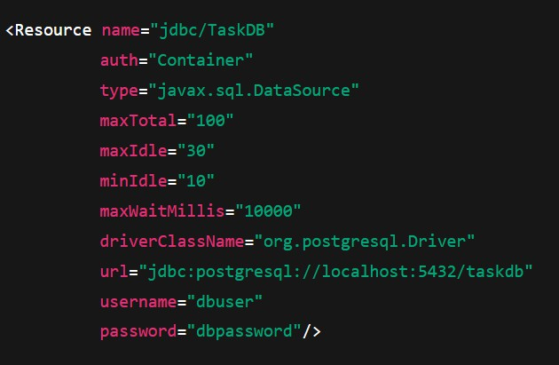
Step 1: Configure the Data Source in Tomcat
Locate the Context Configuration File:
The context.xml file is located in either the conf directory of Tomcat or inside the META-INF folder of your web application.
Add the Resource Configuration:

Slide 3
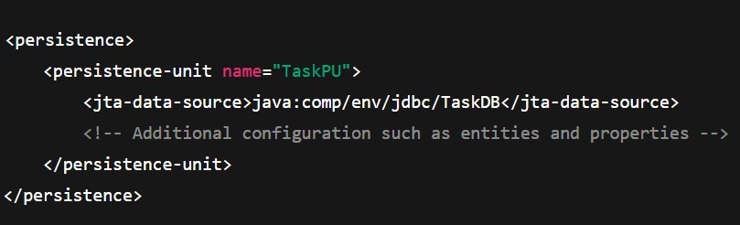
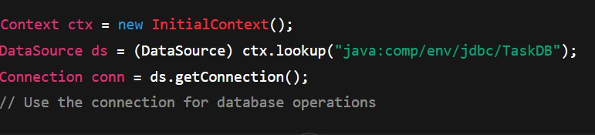
Step 2: Integrate the Data Source with the Java EE Application
Update persistence.xml:
Use JNDI Lookup in Your Java Code:

Slide 4
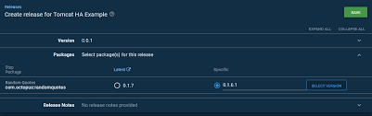
Step 3: Test and Verify Configuration
Deploy the Application:
Upload your web app to Tomcat and start the server. Check catalina.out logs for any datasource errors.
Verify Database Connectivity:
Run a feature that connects to the database (like fetching tasks). If successful, the data source is configured properly.
Monitor Connection Pool:
Check how Tomcat manages connections.
Adjust parameters like maxTotal, maxIdle, etc., if needed.
Step 4: Review and Optimize
Tune connection pool settings for performance.
Document all configuration details for future use.

